Slide 1
Section -1 Introduction and Environment Setup
Data Science and Marketing

Slide 2
Trends in Marketing
Rising importance of digital marketing- Search Engines, Social network, email and websites.
Customize target audience
Choose proper channel to advertise(Ex. Facebook, Instagram)
These channels are more cost effective than traditional marketing channels(TV, Radio…)
Google’s marketing channels- Search Ads, Display Ads, Video Ads, App Ads
Marketing Analytics- Monitoring and analyzing the performance of marketing efforts.
Based on ROI(Return of Investment), can optimize future marketing campaigns.
Personalized and target marketing-Using machine learning and Artificial intelligence predict which customers are more likely to purchase and which items they are going to purchase.
Based on the above results, customize the marketing messages to each of their customes.

Slide 3
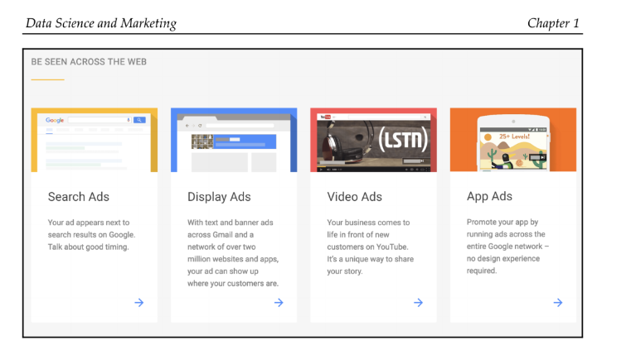
Trends in Marketing

Slide 4
Trends in Marketing
This result in higher ROI.
Many SaaS companies (Oracle, Sailthru) provides platforms for personalized marketing
Sailthru published a retail personalization index report which analyzes how various retail companies use personalized marketing in different marketing channels.
From the above report, can find companies like Walmart uses personalized marketing heavily in their websites, emails and other channels.
Reliance on marketing analytics has gone up from 30% to 42 % in the past 5 years.(February 2018 CO survey)
The CMO Survey collects and distributes the opinions of marketing leaders in order to predict the future of markets, track marketing excellence, and improve the value of marketing in companies and in society.

Slide 5
Applications of data science in Marketing
The trend of marketing has been toward more data driven and quantitative marketing
Basics of Machine Learning
Different types of learning algorithms
Typical Data Science workflow and process

Slide 6
Descriptive vs Explanatory vs Predicitive Analyses
Descriptive Analysis: To understand and describe the given dataset better.
Quantitatively and statistically summarize the information that the dataset contains.
Ex: if you are conducting a descriptive analysis on user purchase history data, can answer for the below questions:
What is the best selling item?
What were the monthly sales like nt he past year?
What is the average price of the items that are sold?

Slide 7
Explanatory Analysis
Purpose of descriptive analysis is to answer the what and how from the data
Explanatory analysis is to answer why using the data
This type analysis is conducted when have a specific question that you want to answer
Ex: e-commerce business, want to know what drives your users to make purchases? (Use Explanatory analysis not descriptive analysis )

Slide 8
Predictive Analysis
This analysis is conducted when there is a specific future event that you would like to predict
The purpose of this analysis is to build machine learning that learn from the historical data and make predictions about events that will happen in future
Ex: e-commerce business, Which user is the most likely to make a purchase within next seven days?
Before predictive analysis, complete descriptive and explanatory to understand the data.

Slide 9
Type of learning algorithms
Supervised learning algorithms: used when the prediction target or outcome is known.
Ex: Which user is the most likely to make a purchase within the next seven days
The prediction target/ outcome is Whether the person made a purchase or not
Based on historical data, we build features like users age, address, purchase date,
Unsupervised learning algorithms: used when we do not have a specific prediction target
Used in clustering and recommendation systems
Ex: Cluster customers base into different subgroups based on their behaviors
Reinforcement learning algorithms: Used when we want the model to learn and train itself without prior knowledge or experience continuously.
The model learns how to make predictions after lots of trials and errors
Ex: When there are multiple marketing strategies you would like to test and choose the one that works best.

Slide 10
Data Science Workflow
1. Problem Definition: Define the problem, the Scope of the project, approach to solve that problem.
Need to brainstorm on what type of analyses (Descriptive, Explanatory, predictive) and type of learning algorithm(Supervised, unsupervised, reinforcement) will be suitable for solving the given problem
2. Data collection: Gather all the data you need to proceed
Purchase the data from third-party vendors, Extract from the web, and use publicly available data.
Depending on the case this step may be trivial or tedious.
3.Data Preparation: Transform your data and prepare it for future steps
If formats are different, then transform and unify the data.
If the data is unstructured, then make it a structured data.

Slide 11
Data Science Workflow
4.Data analysis: Start looking into the data. Descriptive analyses are conducted to compute some descriptive summary statistics and build visual plots to better understand the data.
Also find some recognizable patterns and draw some insights from data.
Also able to find some anomalies in the data, such as missing values, corrupted data, or duplicated records.
5.Feature engineering: The most important part. Requires good domain knowledge of the data as it requires you to transform the raw data into more informative data.
Ex: Transforming text into numerical data, as machine learning algorithms can only learn from the numerical data.
6. Model building: In this step, you can experiment with various learning algorithms to figure out which one works the best for your use case. Model performance evaluation is also very important in this step.

Slide 12
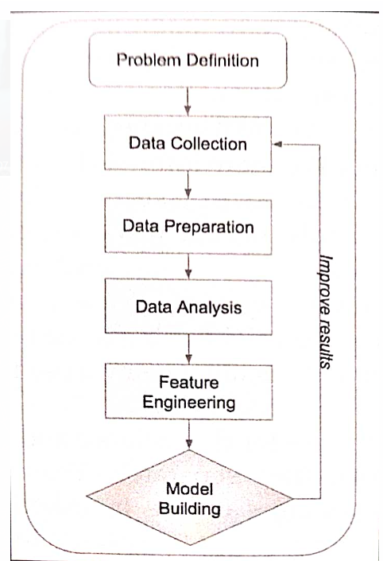
Data Science Workflow

Slide 13
Setting up the python Environment
Installing Anaconda packages:
Pandas for data munging and data analysis
Scikit-learn for building machine learning models
Numpy for mathematical and scientific operations on multi-dimensional data
Install anaconda distribution to get all the above packages
Jupyter Notebook is an open source web application, where we can easily write code, display charts and share notebook with others.
Jupyter notebook is part of the Anaconda distribution

Slide 14
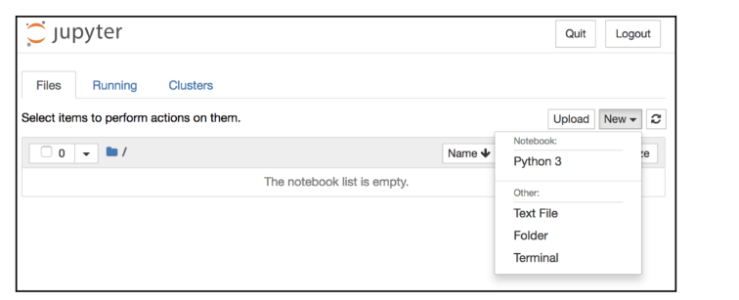
Setting up the python Environment

Slide 15
A simple logistic regression model in Python
import numpy as np
from sklearn.linear_model import LogisticRegression
input_data = np.array([
[0, 0],
[0.25, 0.25],
[0.5, 0.5],
[1, 1],
])
output_data = [
0,
0,
1,
1
]

Slide 16
A simple logistic regression model in Python
logit_model = LogisticRegression()
logit_model.fit(input_data, output_data)
logit_model.coef_
logit_model.intercept_
predicted_output = logit_model.predict(input_data)
predicted_output

Slide 17
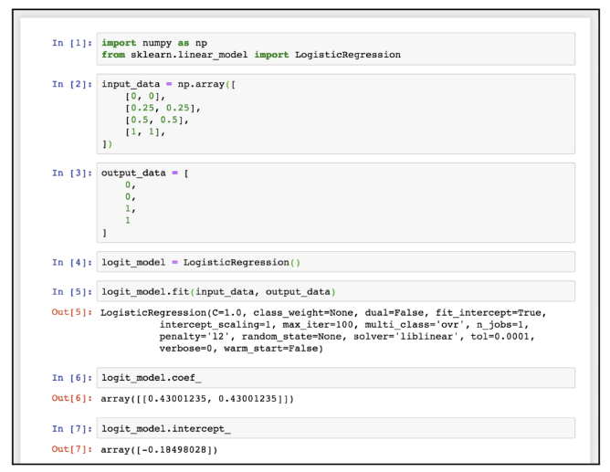
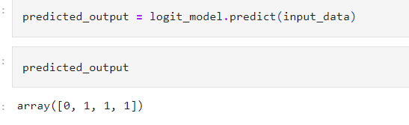
A simple logistic regression model in Python

Slide 18
A simple logistic regression model in Python
%matplotlib inline
import matplotlib.pyplot as plt
plt.scatter(
x=input_data[:,0],
y=output_data,
color=[('red' if x == 1 else 'blue') for x in output_data]
)
plt.xlabel('X')
plt.ylabel('Y')
plt.title('Actual')
plt.grid()
plt.show()

Slide 19
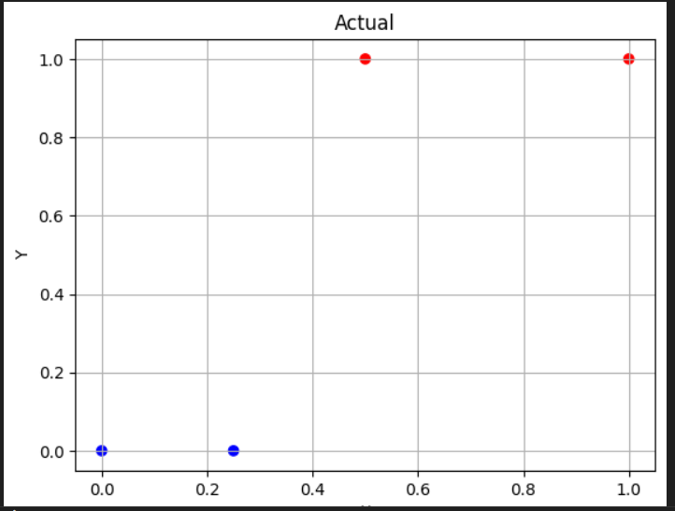
A simple logistic regression model in Python

Slide 20
A simple logistic regression model in Python
plt.scatter(
x=input_data[:,0],
y=predicted_output,
color=[('red' if x == 1 else 'blue') for x in predicted_output]
)
plt.xlabel('X')
plt.ylabel('Y')
plt.title('Predicted')
plt.grid()
plt.show()

Slide 21
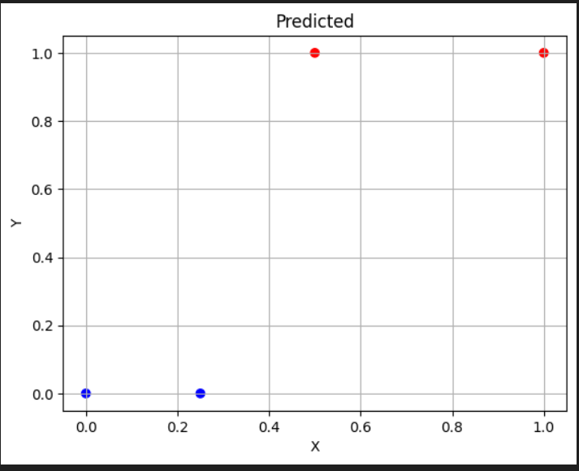
A simple logistic regression model in Python

Slide 22
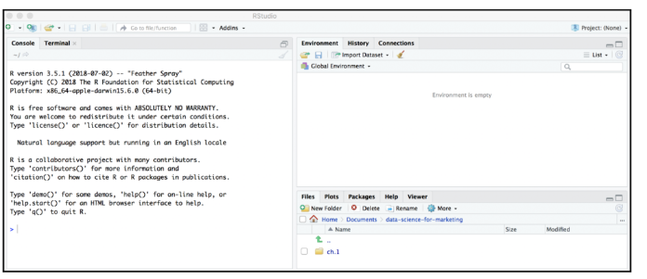
Setting up the R Environment
Installing R and Rstudio

Slide 23
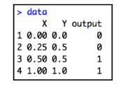
A simple logistic regression model in R
data <- data.frame(
"X"=c(0, 0.25, 0.5, 1),
"Y"=c(0, 0.5, 0.5, 1),
"output"=c(0, 0, 1, 1)
)
logit.fit <- glm(
output ~ X + Y,
data = data,
family = binomial
)

Slide 24
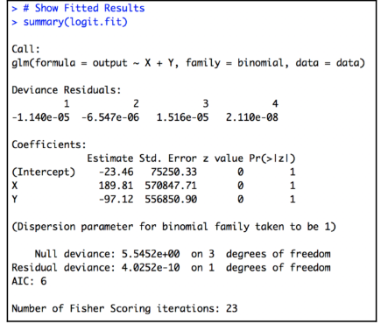
A simple logistic regression model in R
# Show Fitted Results
summary(logit.fit)

Slide 25
A simple logistic regression model in R
# Predict Class Probabilities
logit.probs <- predict(
logit.fit,
newdata=data,
type="response"
)
# Predict Classes
logit.pred <- ifelse(logit.probs > 0.5, 1, 0)
logit.pred

Slide 26
A simple logistic regression model in R
# Plotting Library
library(ggplot2)
# Simple Scatterplot
ggplot(data, aes(x=X, y=output, color=output)) +
geom_point(size=3, shape=19) +
ggtitle('Actual') +
theme(plot.title = element_text(hjust = 0.5))
ggplot(data, aes(x=X, y=output, color=logit.pred)) +
geom_point(size=3, shape=19) +
ggtitle('Predicted') +
theme(plot.title = element_text(hjust = 0.5))

Slide 27
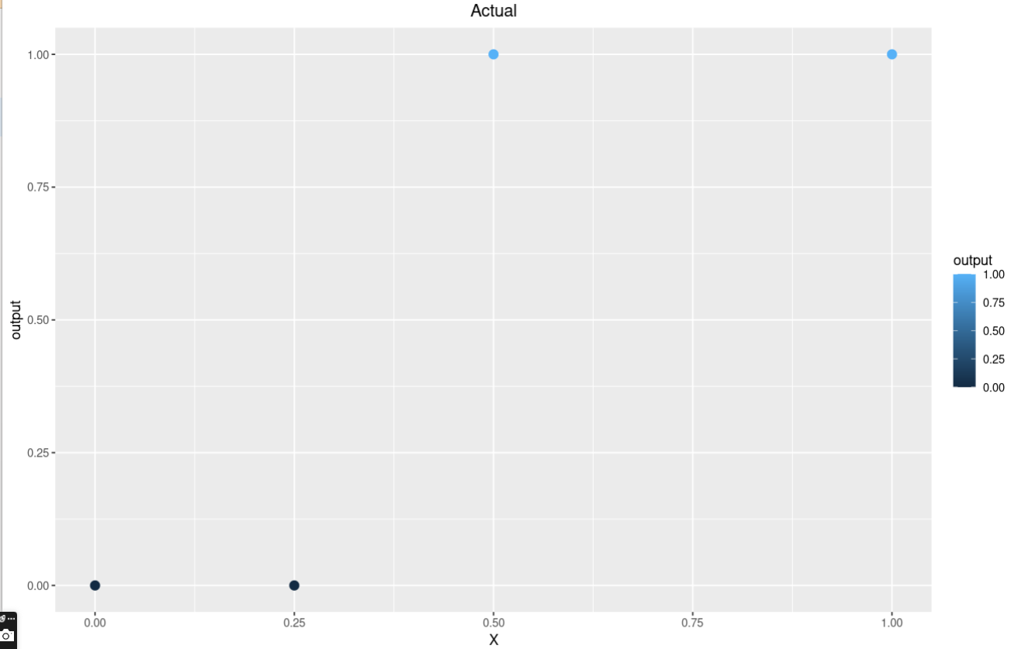
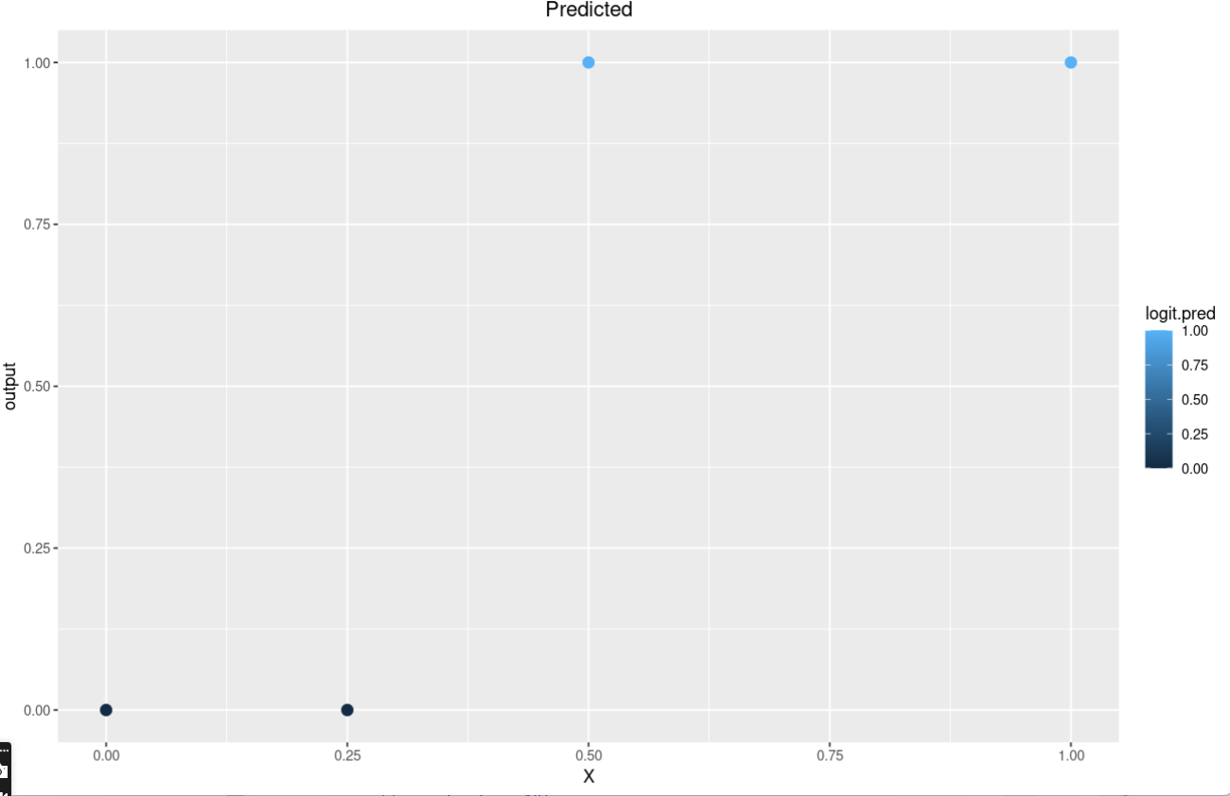
A simple logistic regression model in R

